Slide 1
Working with Nanoparticle Toxicity dataset in python
Programming for
Chemists
Kirill nikifirov
Insaf gainanov
Galina belyaeva
Vladimir gabreian

Slide 2
Outline
GitHub
Process of work
Attempts
Program
Conclusions

Slide 3
GitHub
We won it.

Slide 4

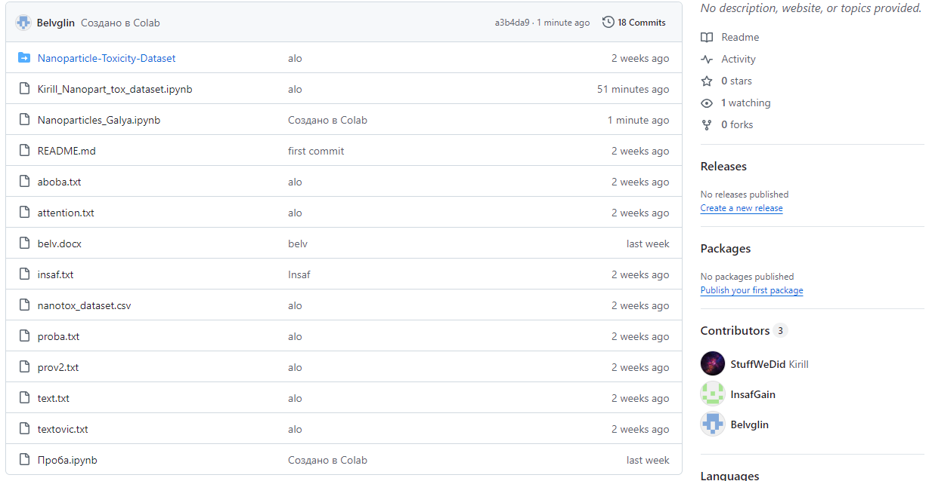
But not for the first attempt

Slide 5
Process of work
Choosing a database
Fighting with GitHub and GitBush: discovered tokens
Structuring the Dataset
Spending a lot of hours on finding the best relations of parameters and matching them to the conscious result
Looking through a lot of courses and papers
Finally got it.

Slide 6
But not without fails
yes, we are chemist, be tolerant

Slide 7
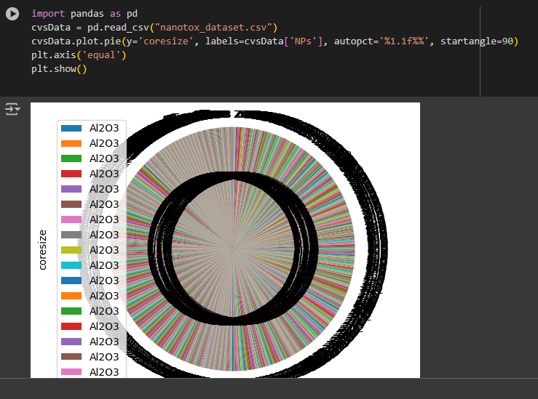
We got this…

Slide 8
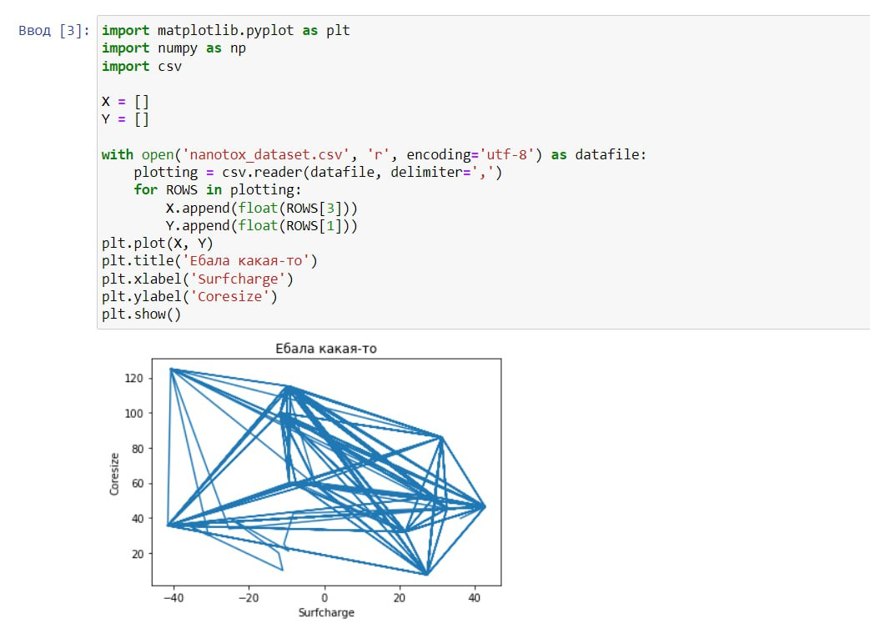
And this…

Slide 9

First of all we find out all relations we could
It was challenging due to:
Experimental type of data
Abundance of source data and only one column with results
In addition this one parameter was uncountable and has data like ‘yes/no’

Slide 10
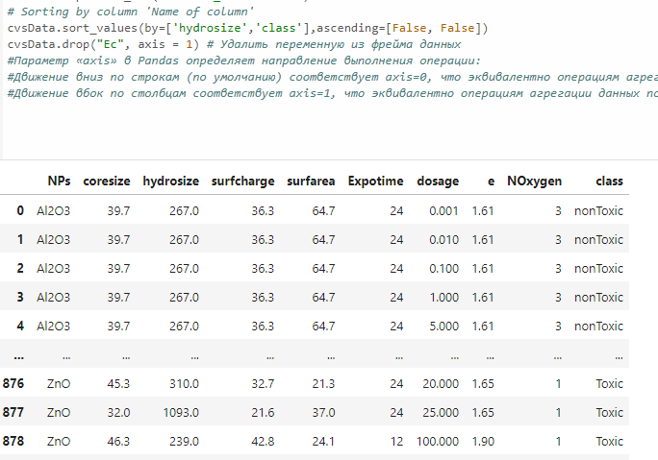
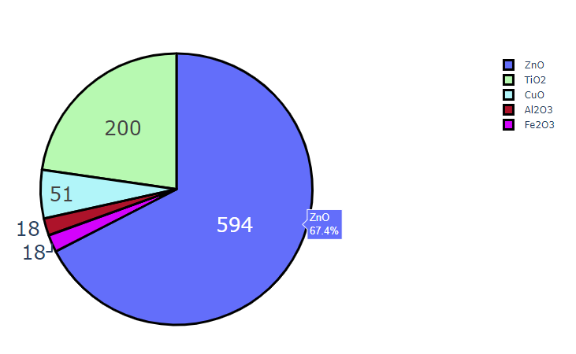
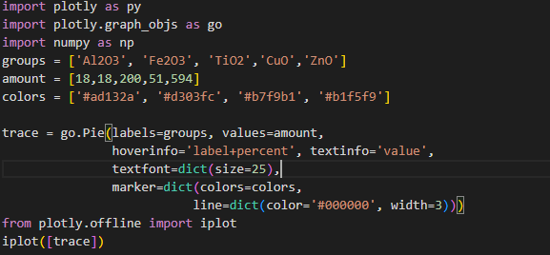
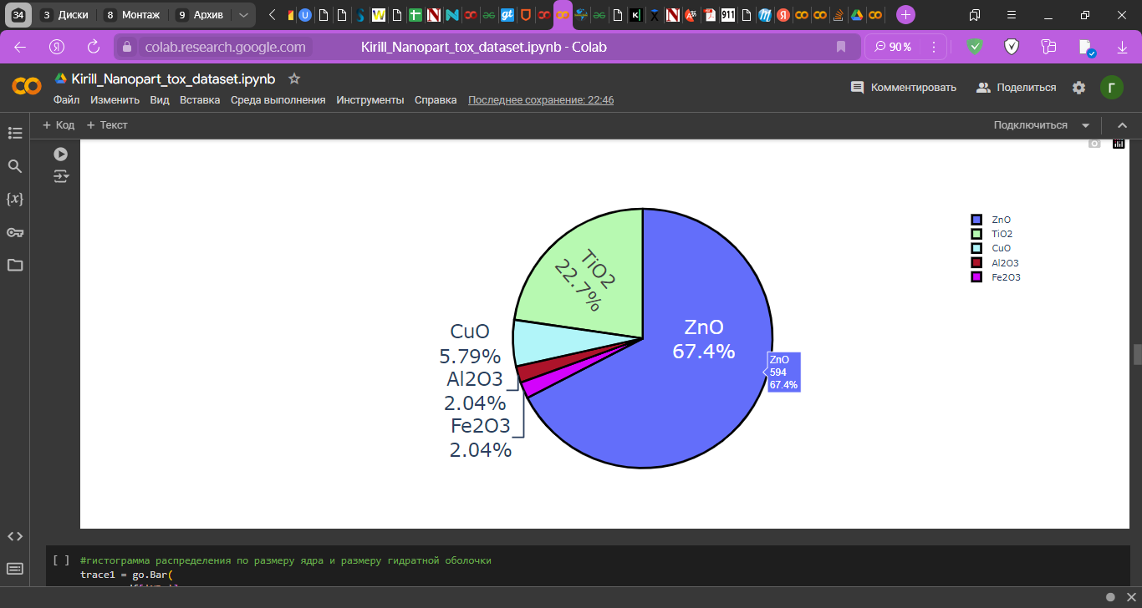
we structured our dataset to get rid of parameters we don’t need

Slide 11
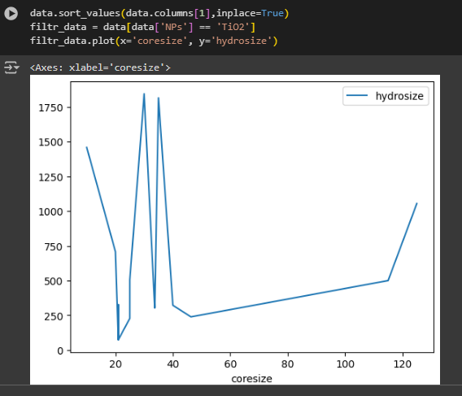
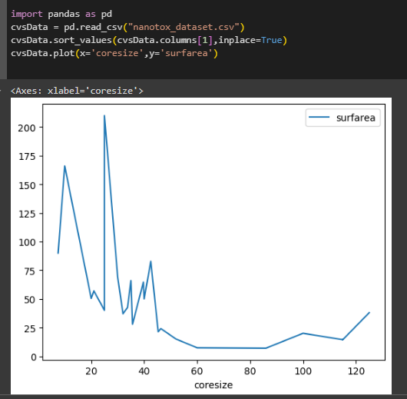
So at first we just draw some graphs

Slide 12
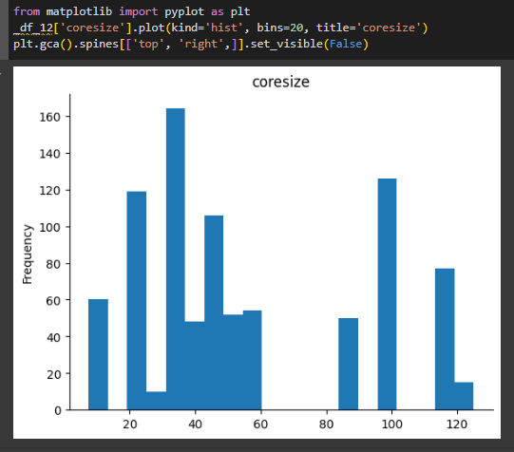
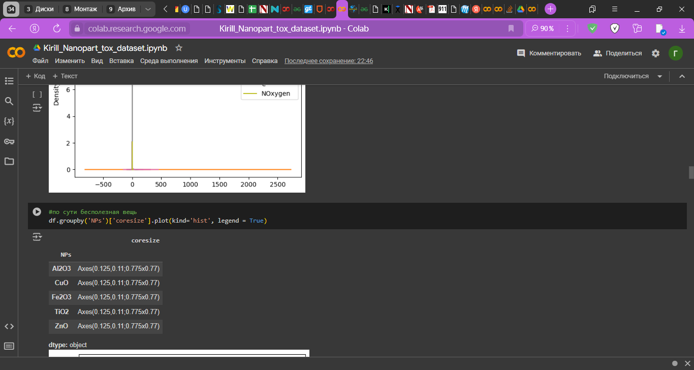
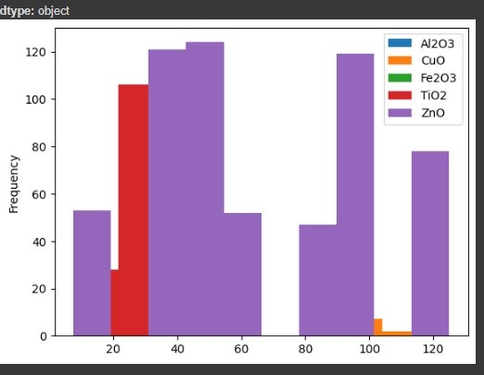
And more

Slide 13
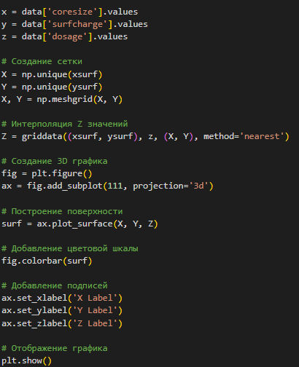
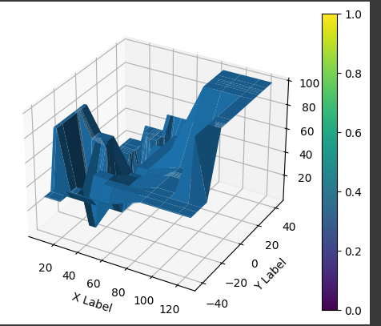
But we upgrade our skill and got this

Slide 14
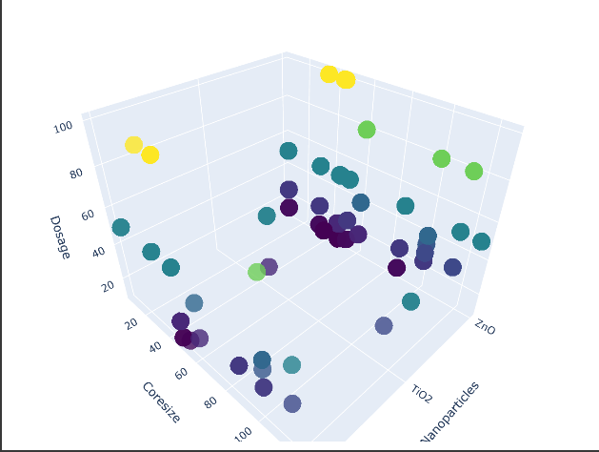
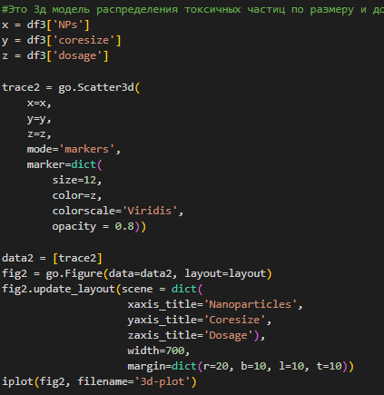
And also this

Slide 15
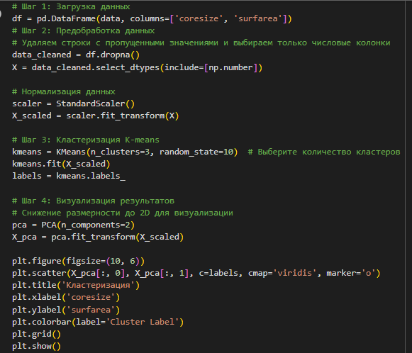
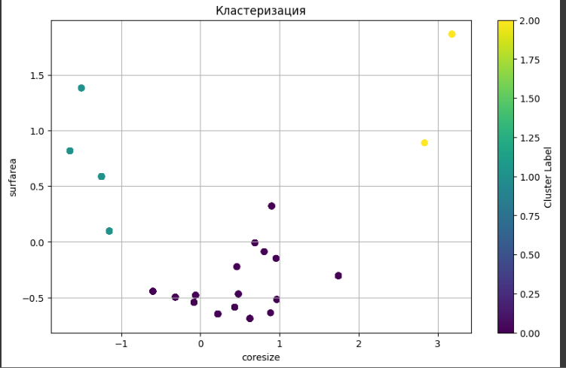
We also made a few more things

Slide 16
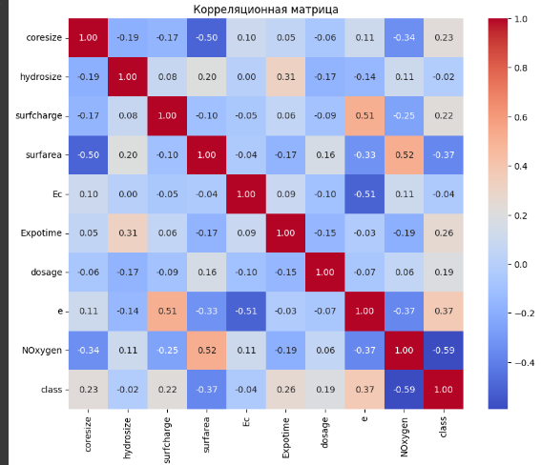
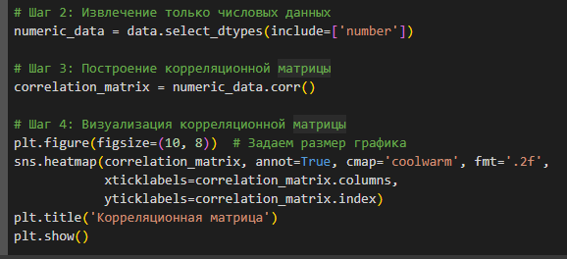
We also made a few more things

Slide 17
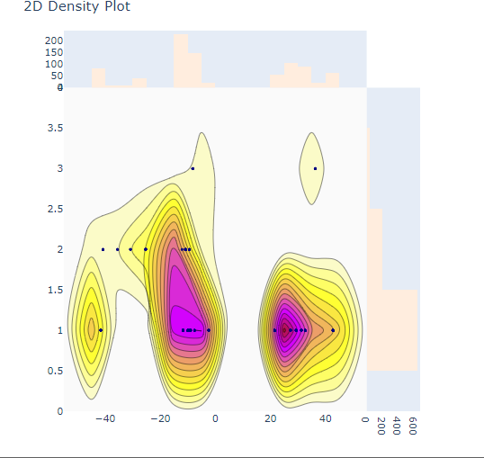
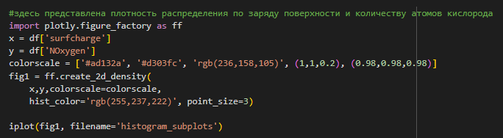
What about more specific information?

Slide 18
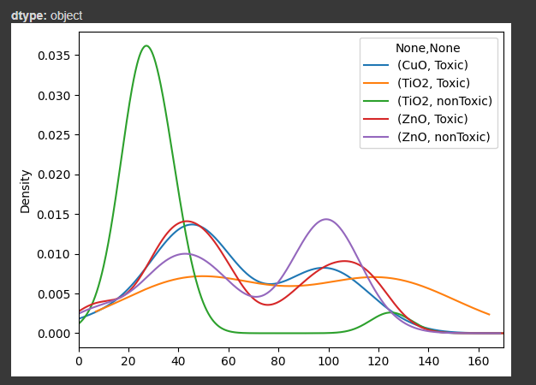
toxicity
df2.groupby(['NPs','class'])['coresize'].plot(kind='kde', xlim=[0,170], legend = True)

Slide 19
Thanks for your attention
(We really did our best)

